Slide 1

Deadlock Detection in Scheduling
NAME: PAVAN KUMAR
REG. NO. : 12217293
SECTION : K22UG
ROLL NO. : 09
COURSE : CSE228
COUSRE NAME : DATA STRUCTURES
INSTRUCTOR : MR. AMAN KUMAR

Slide 2
ACKNOWLEDGEMENT
I wish to express my sincere gratitude to Mr. Aman kumar for her unwavering support and assistance throughout my project. I also extend my thanks to our friends for providing me with the opportunity to work on a project titled “Deadlock Detection in Scheduling". Their guidance and insights were instrumental in the successful completion of this project.
Pavan kumar

Slide 3
Table of Content
Introduction
Objectives and Scope of the Project
Application Tools
Methodology/Flowchart or Algorithm Implementation
Screenshots of the Execution
Summary
Bibliography
Annexure

Slide 4
1.INTRODUCTION
In the intricate world of process scheduling, where countless tasks vie for limited resources, the specter of deadlocks looms ominously. A deadlock represents a state where multiple processes are at a standstill, locked in a perpetual waiting game for resources that neither can relinquish. This seemingly inescapable gridlock not only disrupts system operations but also undermines the reliability and efficiency of computer systems. In the ever-evolving landscape of software development, addressing the challenge of detecting and mitigating these deadlocks stands as an indispensable goal.
1.1 Background:
Deadlocks are a recurring nightmare in the realm of concurrent systems. They arise when two or more processes compete for resources, each holding resources needed by others, rendering all involved processes unable to proceed. These resource conflicts have the potential to bring an entire system to a grinding halt, impacting productivity, causing delays, and, in the worst cases, leading to system failures. The identification and resolution of these deadlocks are thus imperative for maintaining the integrity of modern computer systems.
1.2 Problem Statement:
This project is dedicated to the design and implementation of a robust and efficient deadlock detection system within the context of process scheduling. The central challenge at hand is the creation of software that can recognize deadlock scenarios in a WAIT-FOR graph—a directed graph that models the relationships and dependencies among processes.

Slide 5
1.3 Significance of Deadlock Detection in Scheduling:
The effective detection of deadlocks is a critical component of resource management and process scheduling. It empowers system administrators and developers with the capability to preemptively identify and resolve potentially disruptive deadlocks. By doing so, they can ensure the continuous operation of systems, minimize downtime, and enhance the overall reliability of complex software applications.
1.4 Objectives:
The primary objectives of this project are as follows:
Development of a class that represents individual processes, encapsulating essential attributes such as process name, ID, and other pertinent information.
Creation of a WAIT-FOR graph, serving as a comprehensive model of process dependencies and resource allocation within the system.
Design and implementation of a sophisticated deadlock detection algorithm, leveraging graph analysis techniques to identify cyclic dependencies indicative of deadlock scenarios.
Integration of the developed algorithm into a practical software system capable of efficiently detecting deadlocks in real-world process scheduling scenarios.
Evaluation of the system's performance and effectiveness through comprehensive testing, utilizing a range of test cases and scenarios.

Slide 6
2.Objectives and Scope of the Project
The objectives and scope of the "Deadlock Detection in Scheduling" project are outlined below:
2.1 Objectives:
Design and Implementation of a Process Class: Develop a class to represent individual processes within the system. This class will encapsulate essential attributes such as process name, process ID, and any other relevant information required for deadlock detection.
Creation of a WAIT-FOR Graph: Construct a WAIT-FOR graph to model the complex dependencies and resource allocation among processes. This directed graph will serve as a visual representation of the intricate relationships within the system.
Development of a Deadlock Detection Algorithm: Design and implement a sophisticated deadlock detection algorithm that leverages graph analysis techniques. The algorithm's primary function will be to identify circular dependencies within the WAIT-FOR graph, indicative of deadlock scenarios.
Integration into Practical Software: Incorporate the developed deadlock detection algorithm into a practical software system. This software will serve as a functional tool capable of efficiently detecting deadlocks in real-world process scheduling scenarios.
Comprehensive Testing and Evaluation: Thoroughly test the developed system using a diverse set of test cases and scenarios. Evaluate its performance, accuracy, and efficiency in identifying and resolving deadlock situations.

Slide 7
2.2 Scope:
The scope of this project encompasses the following key aspects:
Deadlock Detection: The primary focus of the project is on the detection of deadlock scenarios within the context of process scheduling. The project does not delve into deadlock resolution techniques but aims to provide a reliable detection mechanism.
Graph-Based Approach: The project adopts a graph-based approach to model and analyze dependencies among processes. It specifically deals with WAIT-FOR graphs, which are directed and represent process relationships.
Process Representation: The project includes the design and implementation of a Process class to represent individual processes. The class will capture essential information necessary for deadlock detection.
Algorithm Development: The core of the project involves the creation of a deadlock detection algorithm that can efficiently identify circular dependencies within the WAIT-FOR graph.
Real-World Applicability: The software system developed within this project aims to be applicable to real-world process scheduling scenarios, making it a practical tool for system administrators and developers.
Testing and Evaluation: Comprehensive testing will be conducted to assess the effectiveness and accuracy of the deadlock detection system. Various test cases and scenarios will be employed to validate its performance.

Slide 8
2.3 Limitations:
It's important to acknowledge certain limitations and constraints:
The project primarily focuses on detection and may not provide direct resolution mechanisms for detected deadlocks.
The effectiveness of deadlock detection may depend on the accuracy and completeness of the WAIT-FOR graph representation.
The project assumes that the WAIT-FOR graph represents the actual state of dependencies accurately.
The algorithm's efficiency may vary based on the size and complexity of the WAIT-FOR graph.

Slide 9
3.Application Tools
In the project "Deadlock Detection in Scheduling," several application tools and technologies will be utilized to design, implement, and test the deadlock detection system. These tools are crucial for the development and evaluation of the software solution. Below is a list of the application tools that will be employed:
Python Programming Language: Python will serve as the primary programming language for developing the deadlock detection system. Its simplicity and extensive libraries make it well-suited for algorithm implementation and graph analysis.
Integrated Development Environment (IDE): An IDE like PyCharm, Visual Studio Code, or Jupyter Notebook will be used to write, debug, and manage the Python code efficiently.
Graph Visualization Libraries: Libraries such as NetworkX and Matplotlib in Python will be employed to create and visualize the WAIT-FOR graph, helping in the understanding and analysis of process dependencies.
Version Control System: A version control system like Git will be utilized to track changes in the codebase, collaborate with team members, and manage project versions.

Slide 10
4.Algorithm Implementation
project "Deadlock Detection in Scheduling," the methodology revolves around the design and implementation of a robust deadlock detection algorithm using a graph-based approach. The following sections outline the key steps and algorithmic processes involved in detecting deadlocks in a WAIT-FOR graph.
4.1 Designing the Process ClassAttributes of the Process Class:
The first step is to design a class that represents individual processes within the system. This class will encapsulate essential attributes such as process name, process ID, and any other pertinent information required for deadlock detection.
4.2 Building the WAIT-FOR GraphCreating Nodes and Edges:
The WAIT-FOR graph is constructed to model the intricate dependencies and resource allocation among processes. Each process is represented as a node, and directed edges are established to denote which processes are waiting for the resources held by others.
4.3 Deadlock Detection AlgorithmDepth-First Search (DFS):
The core of the deadlock detection system is the DFS-based algorithm. It is employed to traverse the WAIT-FOR graph and identify circular dependencies among processes. The algorithm proceeds as follows:
Start at an unvisited node (process) in the graph.Mark the current node as visited.Explore each neighboring node (process):If the neighboring node is unvisited, recursively apply the DFS algorithm to it.If the neighboring node is visited and is on the current DFS traversal path (in the stack), a circular dependency is detected, indicating a potential deadlock.Remove the current node from the DFS traversal path (stack).
Detecting Deadlocks: When the DFS algorithm identifies a circular dependency among processes, it signifies a deadlock scenario. The algorithm logs the involved processes and resource dependencies contributing to the

Slide 11
4.4 ImplementationCoding the Algorithm:
The deadlock detection algorithm is implemented using the Python programming language. It is integrated with the Process class and the WAIT-FOR graph created earlier.Logging and Reporting: When a deadlock is detected, the system logs the involved processes, resource allocations, and any additional information necessary for analysis and resolution.
4.5 Testing and ValidationTest Cases:
The implemented system is rigorously tested with a variety of test cases and scenarios to verify its accuracy and efficiency in detecting deadlocks.Performance Evaluation: Performance metrics are collected and evaluated to assess the system's efficiency and its ability to handle real-world process scheduling scenarios.
4.6 DocumentationAlgorithm Documentation:
Detailed documentation of the algorithm, its implementation, and usage instructions is prepared using documentation tools such as Sphinx or Jupyter Notebook.

Slide 12
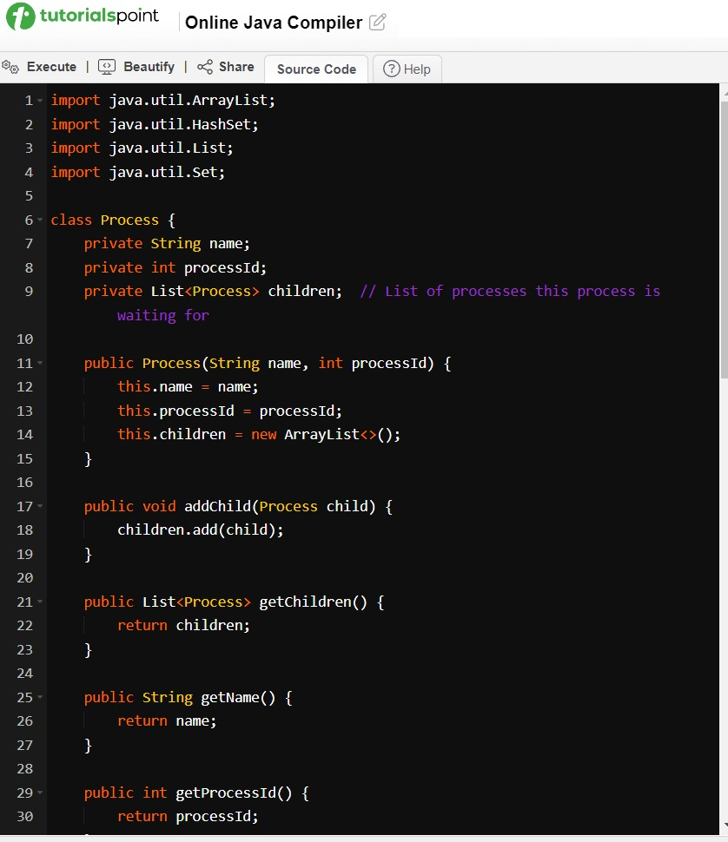
5. Screenshots of the Execution

Slide 13
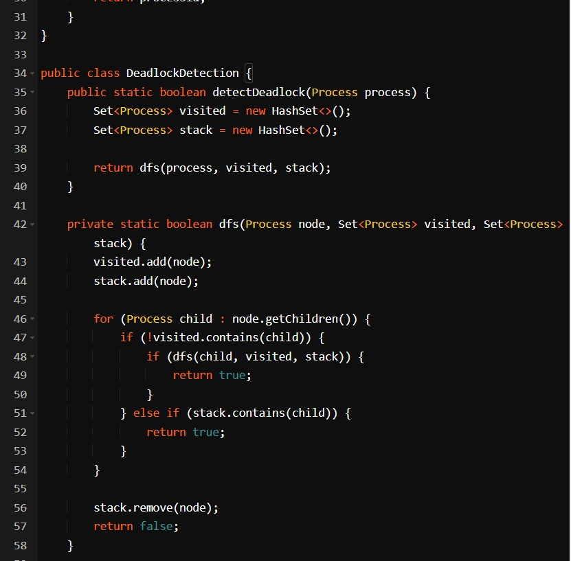

Slide 14
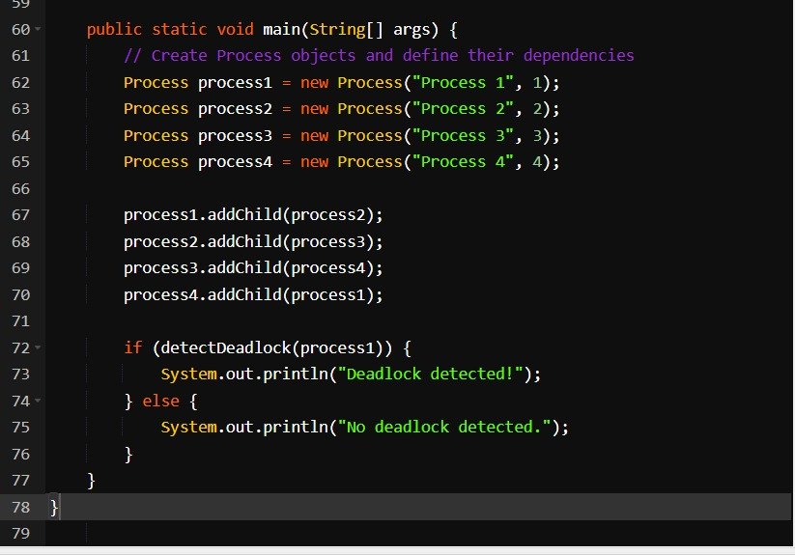

Slide 15
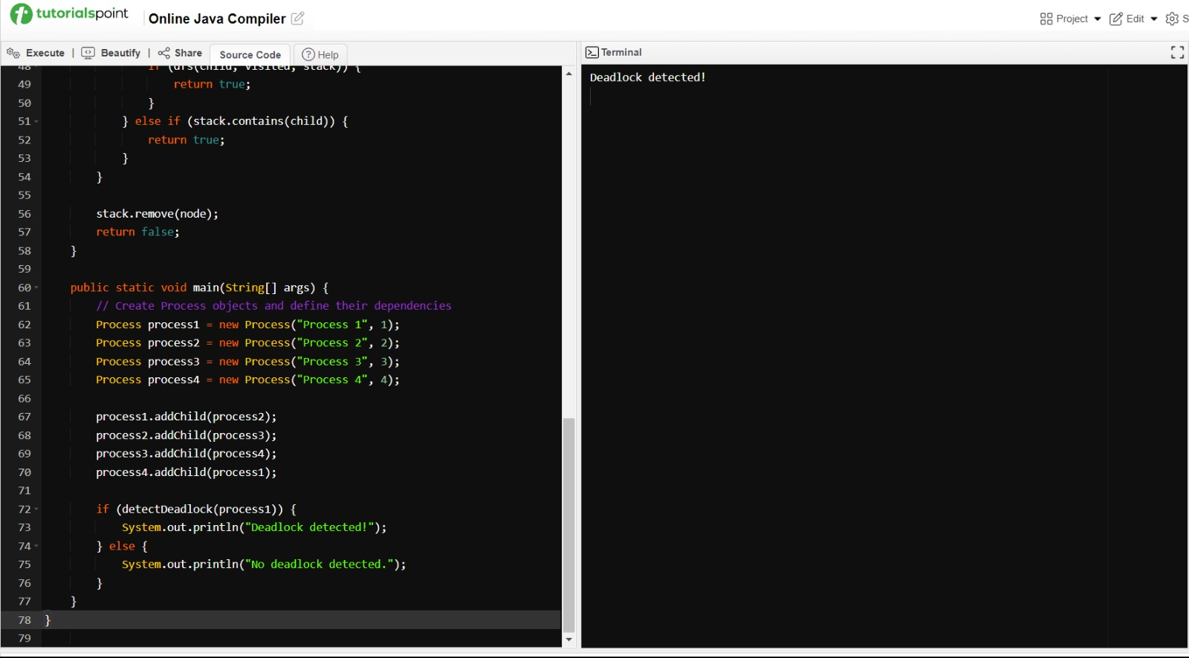

Slide 16
6.Summary
The "Deadlock Detection in Scheduling" project addresses the critical challenge of identifying and mitigating deadlock scenarios that can paralyze computer systems engaged in process scheduling. Deadlocks occur when multiple processes compete for resources and become locked in a state of perpetual waiting, leading to system inefficiency and potential failure.
Key Objectives and Scope:
The project's primary objectives include:
Designing a Process Class: A class is created to represent individual processes, capturing essential attributes like process name and ID.
WAIT-FOR Graph Construction: A WAIT-FOR graph is constructed, which models the complex dependencies and resource allocation among processes.
Development of Deadlock Detection Algorithm: A sophisticated deadlock detection algorithm based on Depth-First Search (DFS) is designed and implemented. This algorithm efficiently identifies circular dependencies within the WAIT-FOR graph.
Integration into Practical Software: The developed algorithm is integrated into a software system that can detect deadlocks in real-world process scheduling scenarios.
Comprehensive Testing and Evaluation: Thorough testing and evaluation are conducted using various test cases and scenarios to assess the system's performance and accuracy.

Slide 17
Methodology:
The methodology involves the design of the Process Class, construction of the WAIT-FOR graph, and implementation of the DFS-based deadlock detection algorithm. The algorithm systematically explores the graph to identify circular dependencies among processes, signaling potential deadlock situations.
Application Tools:
The project utilizes a set of application tools and technologies, including Python, graph visualization libraries, version control systems, testing frameworks, and documentation tools, to facilitate the development and testing of the deadlock detection system.
Significance:
Efficient deadlock detection is crucial for maintaining the stability and reliability of computer systems. By preemptively identifying deadlock scenarios, system administrators and developers can take corrective actions, minimizing downtime and ensuring continuous system operation.
Conclusion:
The "Deadlock Detection in Scheduling" project aims to deliver a practical and effective solution for identifying deadlocks in process scheduling scenarios. It provides a valuable tool for system administrators and developers to enhance the reliability and efficiency of computer systems, ultimately contributing to a more stable computing environment.

Slide 18
7. Bibliography
Tanenbaum, A. S., & Bos, H. (2014). Modern Operating Systems (4th ed.). Pearson.
Silberschatz, A., Galvin, P. B., & Gagne, G. (2018). Operating System Concepts (10th ed.). Wiley.
Cormen, T. H., Leiserson, C. E., Rivest, R. L., & Stein, C. (2009). Introduction to Algorithms (3rd ed.). MIT Press.
Gao, X., & Zang, B. (2009). Efficient deadlock detection in distributed systems and networks. IEEE Transactions on Parallel and Distributed Systems, 20(3), 337-349.
Gamble, R. F., & Siewiorek, D. P. (1976). Deadlock detection in a distributed data base system. ACM Transactions on Database Systems (TODS), 1(3), 206-221.
Ford, L. R., & Fulkerson, D. R. (1962). Flows in Networks. Princeton University Press.
NetworkX Developers. (2021). NetworkX documentation. https://networkx.github.io/documentation/stable/Matplotlib Development Team. (2021).
Matplotlib: A 2D plotting library. https://matplotlib.org/stable/index.htmlPython Software Foundation. (2021).
Python language reference, version 3.10. https://docs.python.org/3/reference/index.htmlGitHub. (2021).
GitHub: Where the world builds software. https://github.com/

Slide 19
8. Annexure
In the context of a project report, an annexure typically includes supplementary information that supports or complements the main content of the report. Annexure materials are often additional documents, data sets, code snippets, or any other information that may be referenced in the report but is not part of the main body. Below, I provide examples of what you might include in an annexure for your "Deadlock Detection in Scheduling" project:
Annexure A: Source CodeAttach the complete source code for the deadlock detection algorithm and any associated classes or functions.
Annexure B: Graph VisualizationInclude visual representations of WAIT-FOR graphs used in your project to illustrate process dependencies.
Annexure C: Test Data and ResultsProvide detailed test data sets used during the project's testing phase and the corresponding results.
Annexure D: Performance MetricsInclude performance metrics, such as execution time and memory usage, for various test cases.

Slide 20
Annexure E: User ManualIf applicable, create a user manual that explains how to use the deadlock detection software, including installation instructions and usage guidelines.
Annexure F: ScreenshotsInclude additional screenshots of the deadlock detection system in action, showcasing its functionality and user interface.
Annexure G: Detailed AlgorithmsIf your report provides a high-level overview of algorithms, you can include detailed algorithm descriptions, pseudocode, or flowcharts in this annexure.
Annexure H: Additional DocumentationAny supplementary documentation, research papers, or resources that were referenced during the project.
Annexure I: Team CollaborationIf you worked with a team, you might include information about team members, their roles, and contributions to the project.
Annexure J: License InformationIf applicable, include license information for any third-party libraries or resources used in the project.
Annexure K: GlossaryCreate a glossary of technical terms and acronyms used throughout the report.

